Slide 1


Slide 2
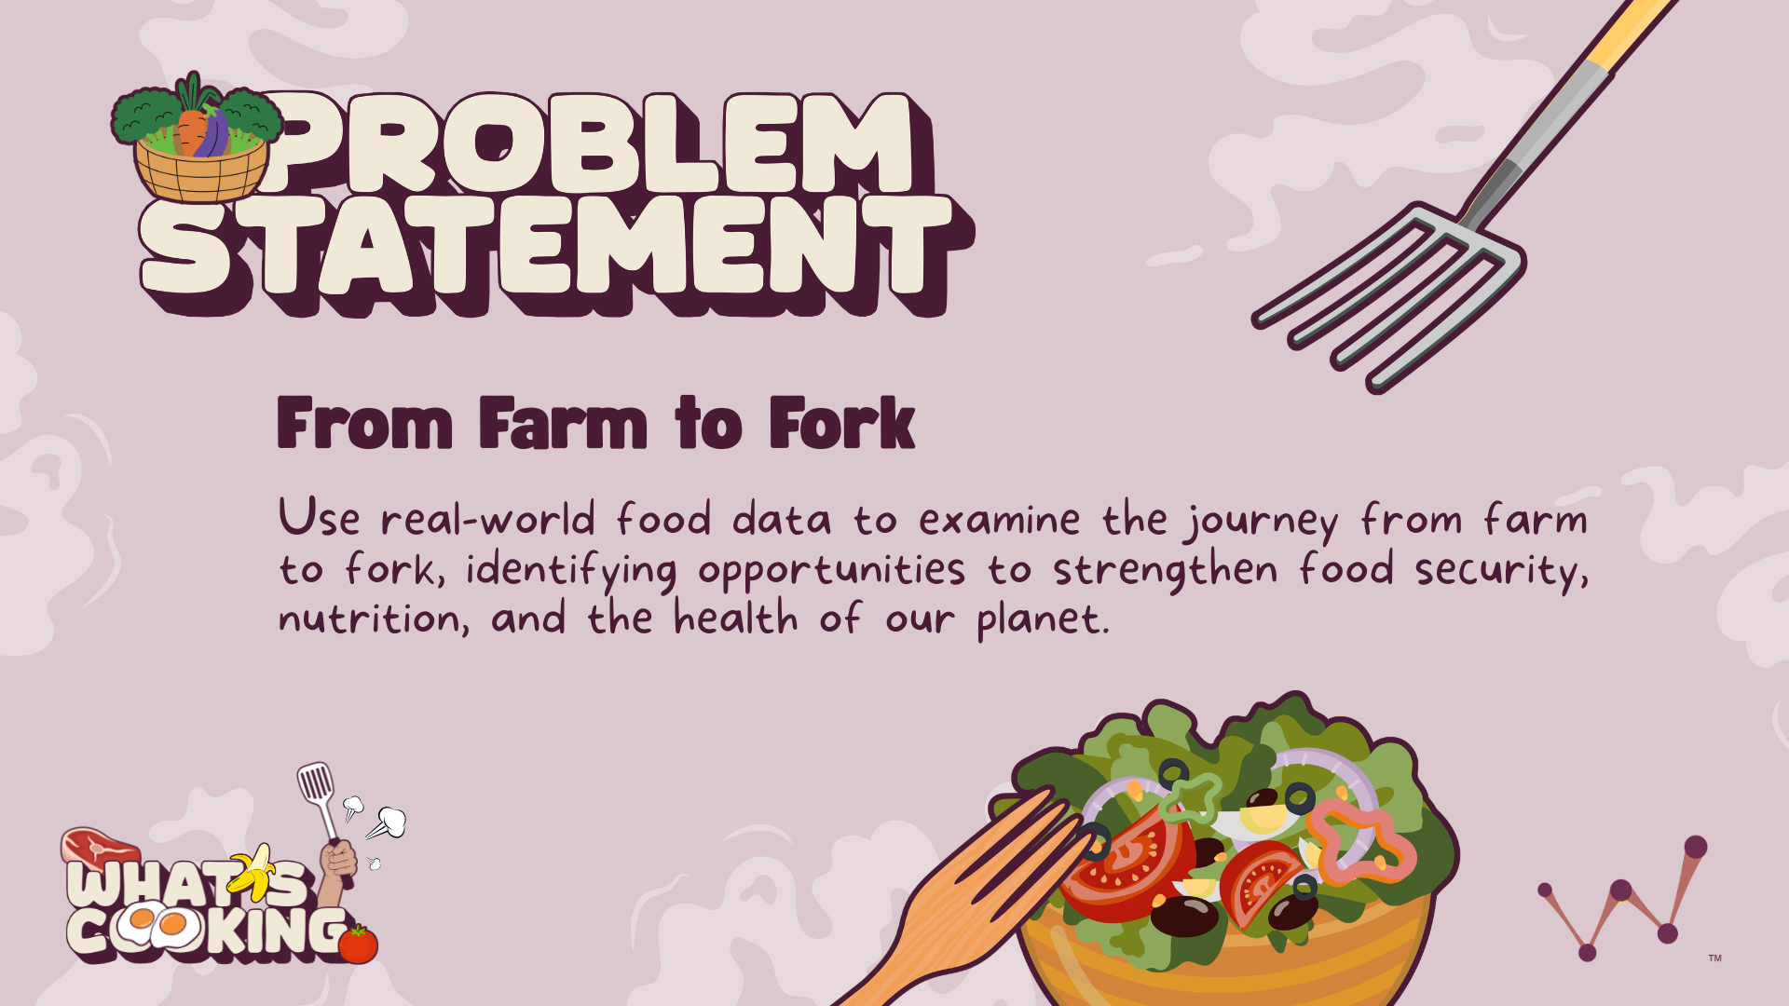

Slide 3
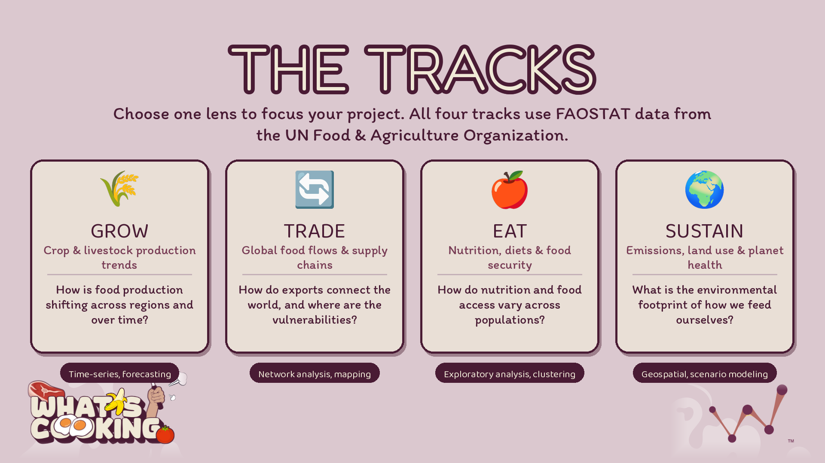

Notes:
Grow — Crop & livestock production trends
Problems: How production is shifting across regions and over time, what's driving changes in yield and output, forecasting future production.
Skills & technologies: Time-series analysis, trend and growth-rate modeling, forecasting (ARIMA, regression), and data cleaning across long historical datasets. A good fit for teams wanting to strengthen statistical analysis and predictive modeling.
Trade — Global food flows & supply chains
Problems: How countries connect through imports/exports, where supply-chain dependencies or vulnerabilities exist, how trade flows shift after disruptions.
Skills & technologies: Network analysis, geospatial mapping, flow visualization, and relational data work (joining and pivoting large trade-matrix datasets). Strong for teams interested in network graphs, mapping, and data visualization.
Eat — Nutrition, diets & food security
Problems: How nutrition and food access vary across populations, where food-security gaps exist, relationships between diet, availability, and outcomes.
Skills & technologies: Exploratory data analysis, comparative/statistical analysis, correlation and clustering, and dashboard-style visualization. A great entry point for teams that want to sharpen EDA, storytelling, and insight communication, and it's approachable for less technical members.
Sustain — Emissions, land use & planet health
Problems: The environmental footprint of food production, where the highest-impact opportunities to reduce emissions or land use lie, tradeoffs between output and sustainability.
Skills & technologies: Geospatial analysis, multi-variable and scenario modeling, correlation across environmental and production datasets, and impact visualization. Good for teams wanting to work with more complex, multi-source analysis and ML.
A quick recommendation:
If your team is newer or wants to build core EDA + storytelling skills → Eat is the most approachable.
If they want predictive modeling / forecasting practice → Grow.
If they're excited about mapping, network graphs, and visualization → Trade.
If they want the most complex, multi-source analytical challenge → Sustain.

Slide 4
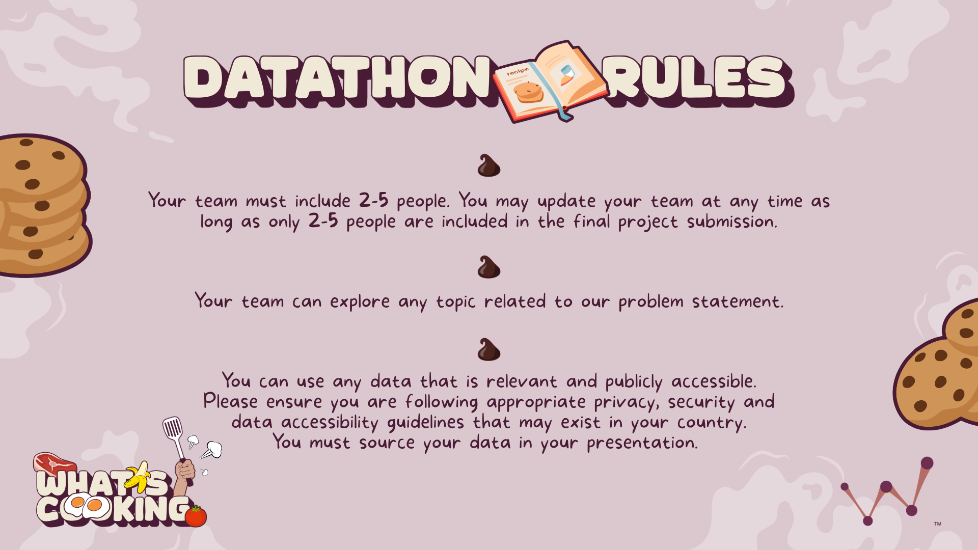

Slide 5


Slide 6
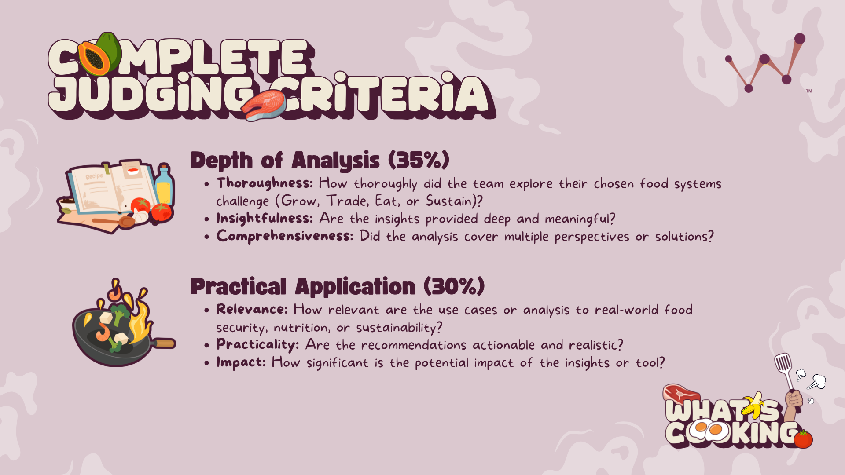

Slide 7
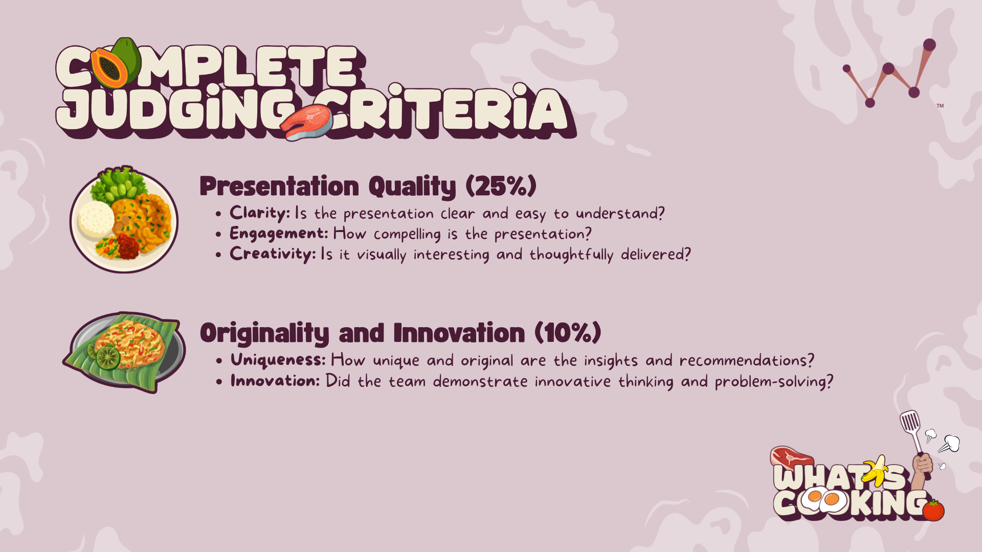

Slide 8
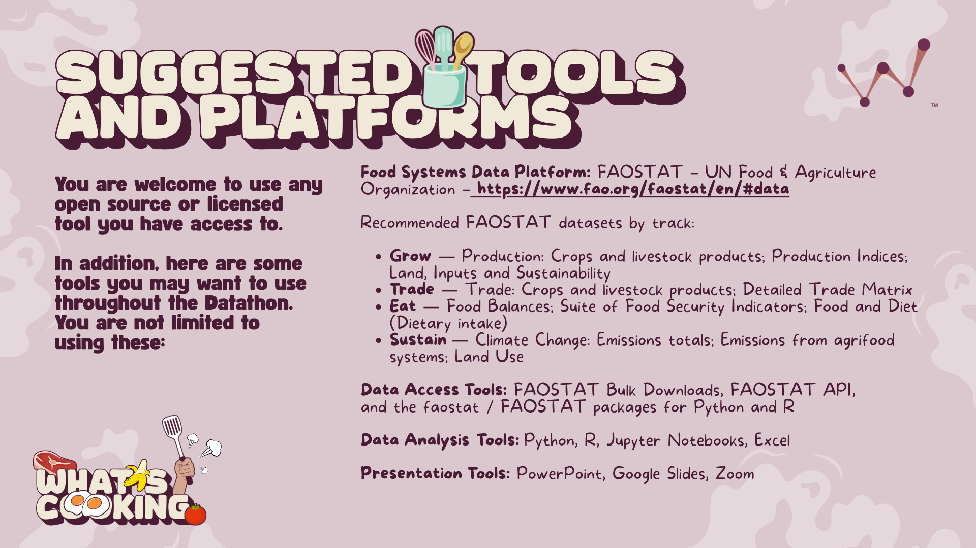
Link here

Slide 9
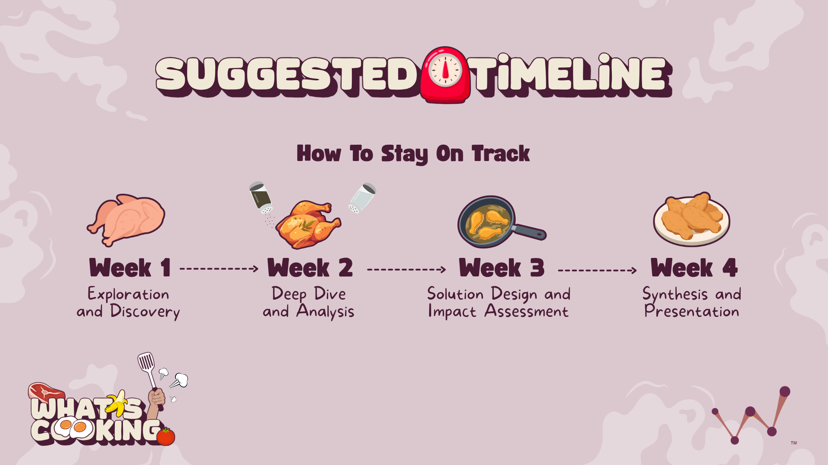

Slide 10
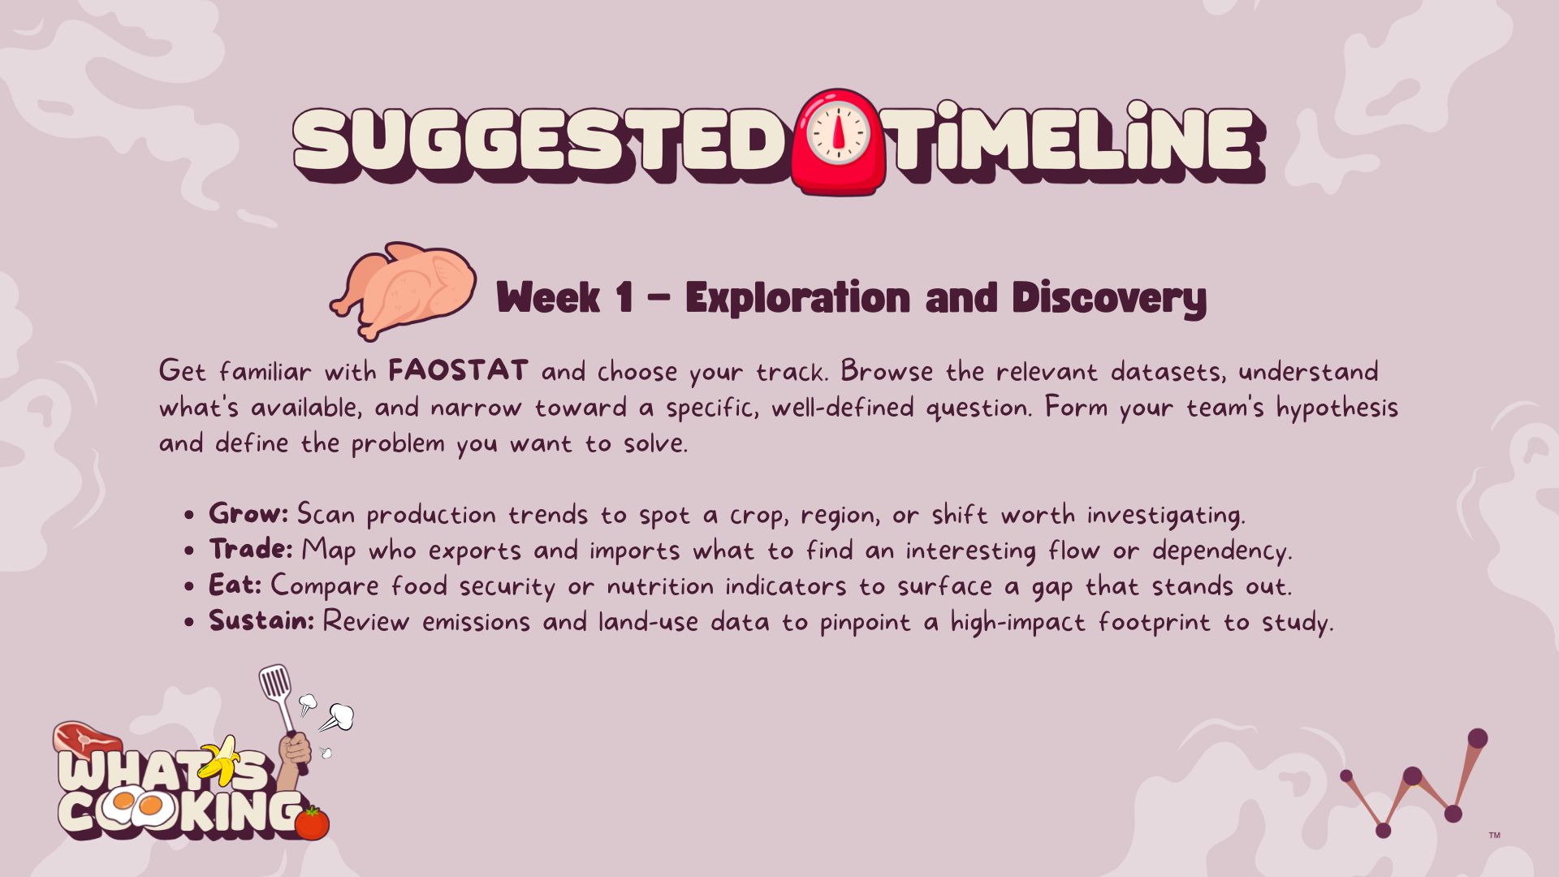

Slide 11
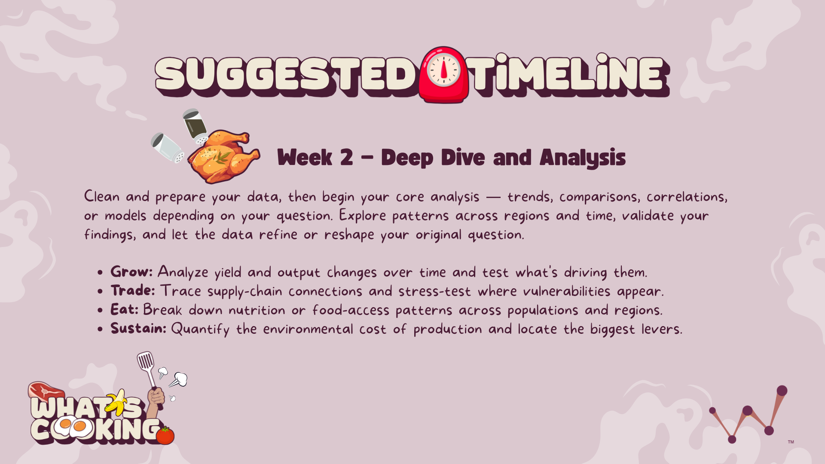

Slide 12
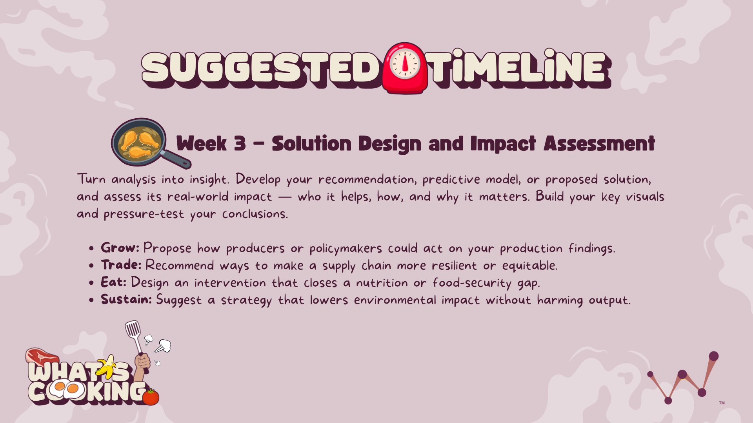

Slide 13
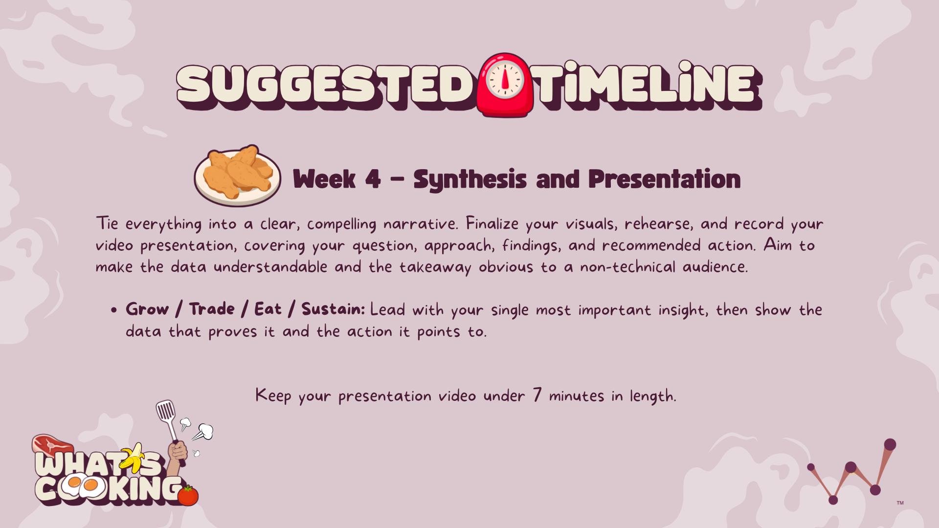

Slide 14
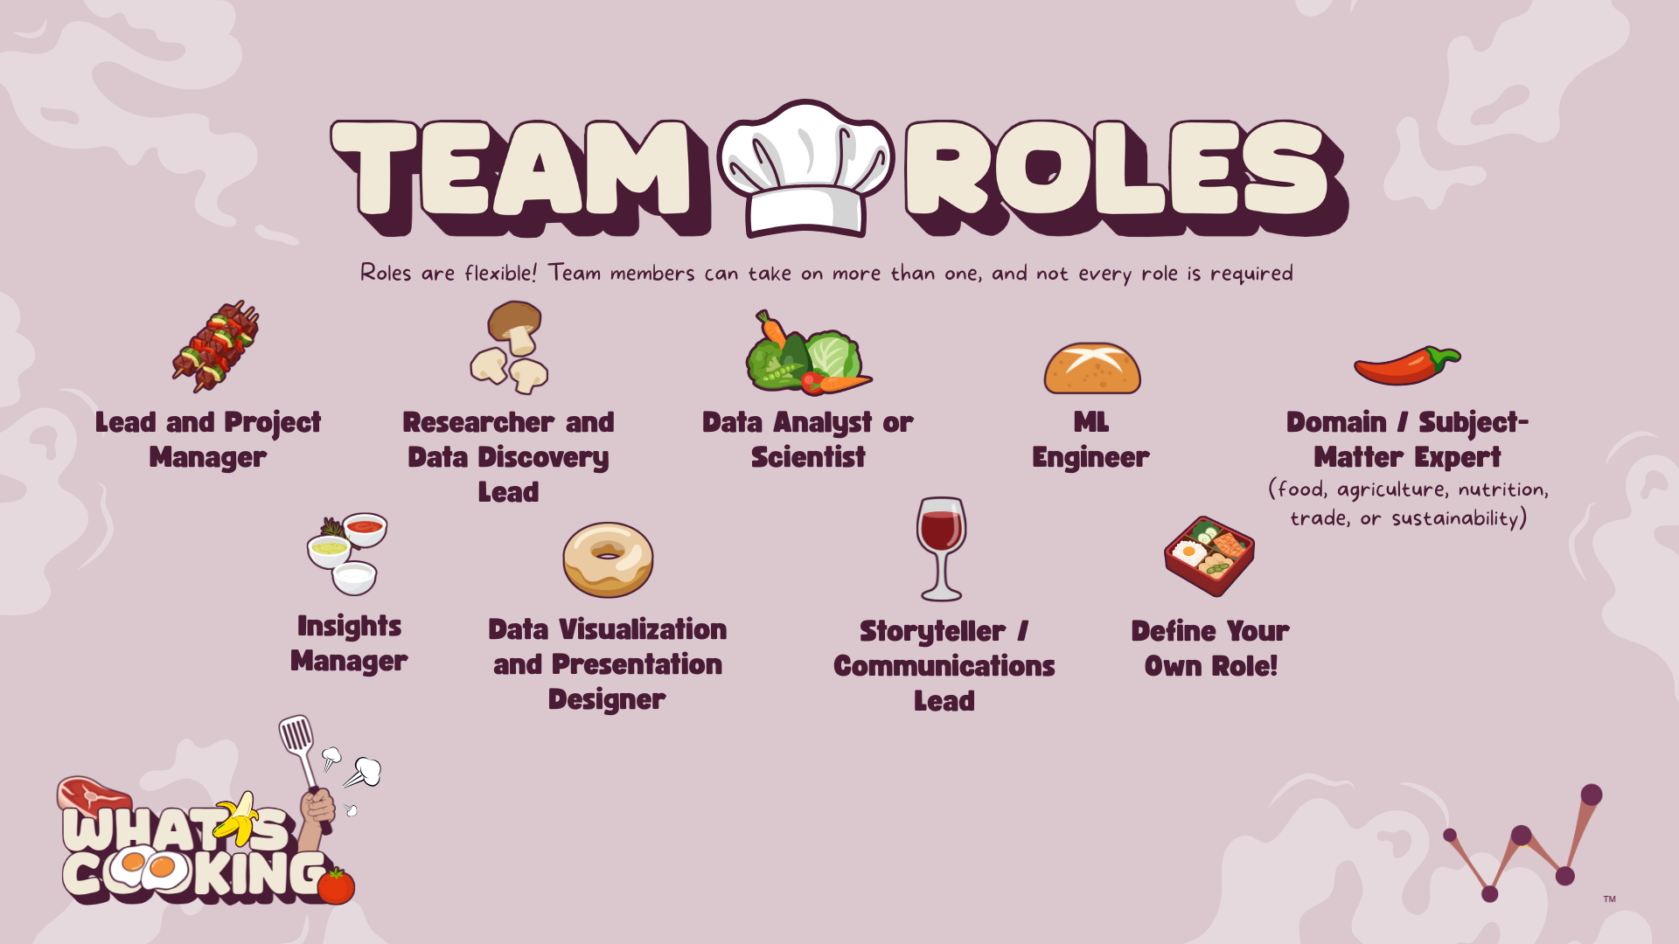

Slide 15

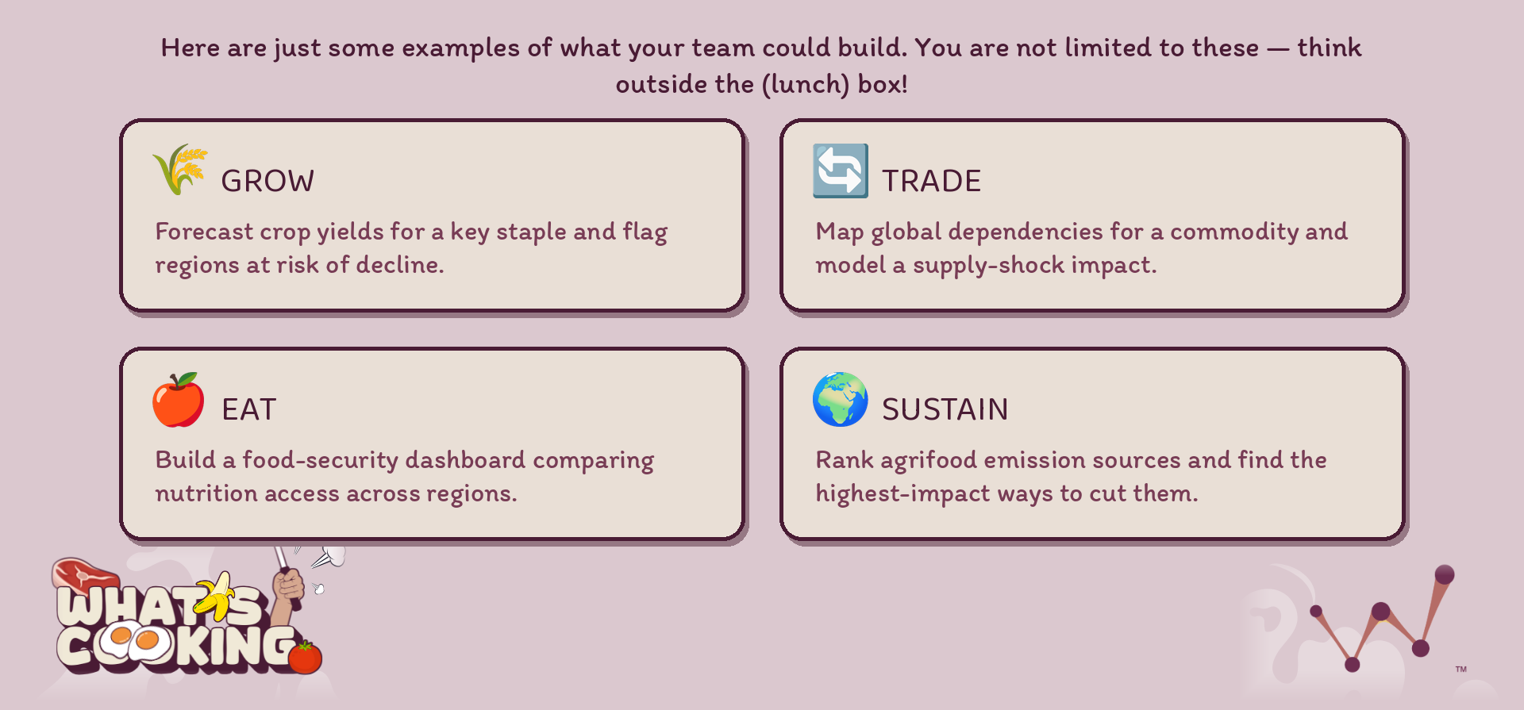

Slide 16
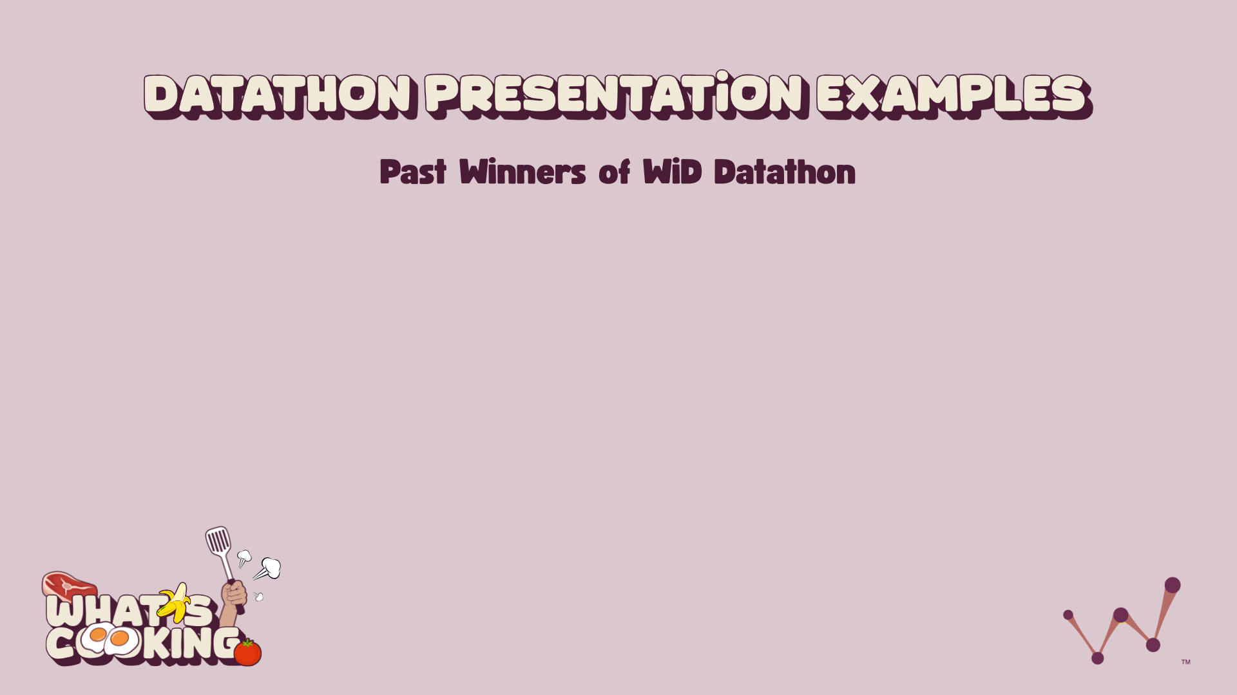
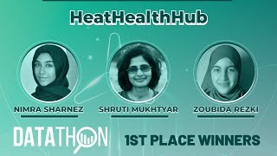
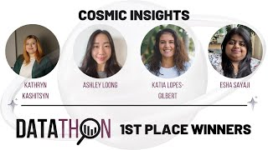
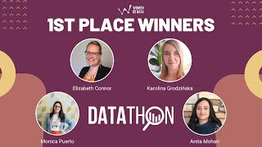
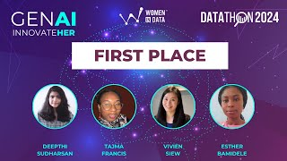

Slide 17

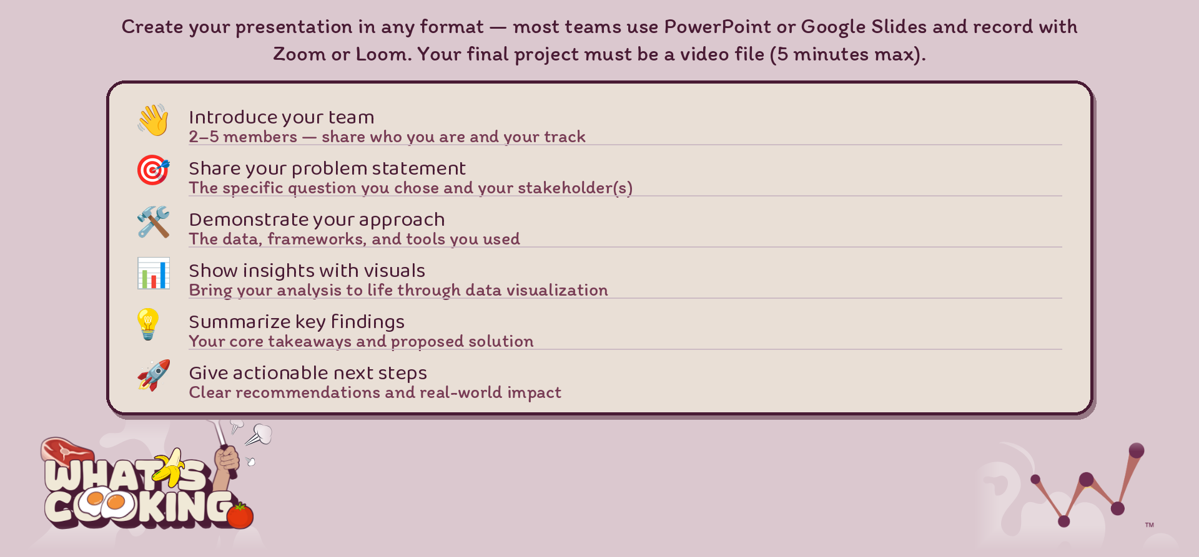
(7 Minutes Max!)
Read the full Presentation outline here.

Slide 18

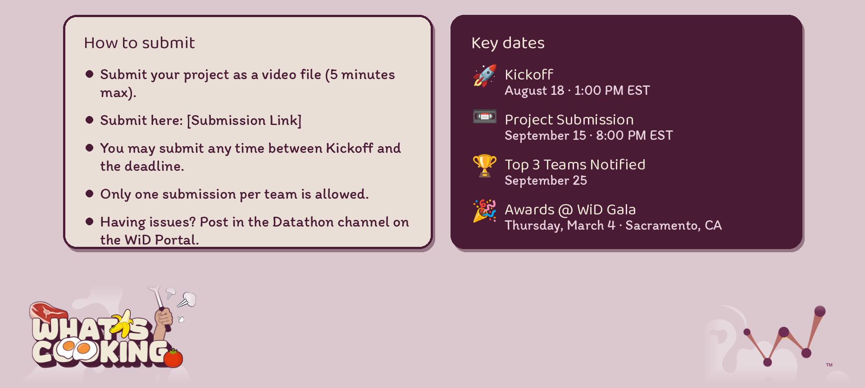
7
_____________________

Slide 19

Link here

Slide 20

Ask your questions here

